Slide 1

Speeding Up Compressed Suffix Array Queries
Herman Perera, Christina Boucher, and Massimiliano Rossi
University of Florida
Notes:
Hey everybody, my name is Herman Perera and today I’ll be talking about how we’ve been working to speed up compressed suffix array queries. I’m an undergraduate researcher at Dr. Boucher’s lab and I’ve been working with Massimiliano Rossi and Christina Boucher. With that being said, let’s get into it.

Slide 2
Compressed Suffix Arrays
- Invaluable tool in compressing large genomic data which has been rapidly growing over the last decade.
- Problems of optimally querying these data structures in limited amounts of space is important.

Slide 3
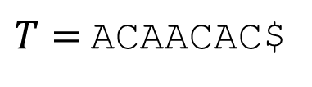
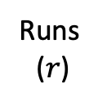

FM-index
Ferragina, Manzini, “Opportunistic data structures with applications” [FOCS 2000]
- Using the Burrows Wheeler Transform (BWT)…
- An input text may be compressed and used for fast substring queries.
- Suffix Array (SA) samples at constant intervals.
$T=$ ACAACAC$
SA
$$ℳ$$
BWT
7 $ACAACAC
2 AACAC$AC
5 AC$ACAAC
0 ACAACAC$
3 ACAC$ACA
6 C$ACAACA
1 CAACAC$A
4 CAC$ACAA
Runs
($r$)
Notes:
The most famous index for the reference genome is the FM-index which allows fast substring queries in compressed space. It is composed by the Burrows-Wheeler transform, which is the last column of the matric of the sorted rotations of the text. And the suffix array, which marks the starting position of each rotation in the original text, sampled at constant distance intervals. The BWT can be easily stored and used in run-length compressed space. The problem of the FM-index is that the space scales linearly with the length of the text.

Slide 4
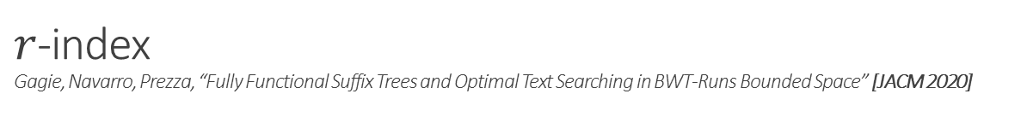
$r$-index
Gagie, Navarro, Prezza, “Fully Functional Suffix Trees and Optimal Text Searching in BWT-Runs Bounded Space” [JACM 2020]
- Improvement on the FM-index for repetitive datasets.
- Stores the same data in fewer runs and smaller space.
- With the added help of an additional data structure to reconstruct the suffix array.
$T=$ ACAACAC$
SA
$$ℳ$$
BWT
7 $ACAACAC
2 AACAC$AC
5 AC$ACAAC
0 ACAACAC$
3 ACAC$ACA
6 C$ACAACA
1 CAACAC$A
4 CAC$ACAA
Runs
($r$)
Notes:
To overcome this issue, Gagie et al., in 2020 proposed a variation of the FM-index, called the r-index, where the number of suffix array samples grows with the number of runs of the BWT.

Slide 5
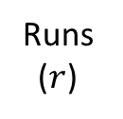

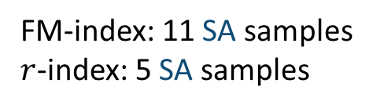

Samples
$T=$ ACAACACAACAACACAACAC$
FM
$$r$$
20
7
15
2
10
18
5
13
0
8
16
3
11
19
6
14
1
9
17
4
12
20 $ACAACACAACAACACAACAC
7 AACAACACAACAC$ACAACAC
15 AACAC$ACAACACAACAACAC
2 AACACAACAACACAACAC$AC
10 AACACAACAC$ACAACACAAC
18 AC$ACAACACAACAACACAAC
5 ACAACAACACAACAC$ACAAC
13 ACAACAC$ACAACACAACAAC
0 ACAACACAACAACACAACAC$
8 ACAACACAACAC$ACAACACA
16 ACAC$ACAACACAACAACACA
3 ACACAACAACACAACAC$ACA
11 ACACAACAC$ACAACACAACA
19 C$ACAACACAACAACACAACA
6 CAACAACACAACAC$ACAACA
14 CAACAC$ACAACACAACAACA
1 CAACACAACAACACAACAC$A
9 CAACACAACAC$ACAACACAA
17 CAC$ACAACACAACAACACAA
4 CACAACAACACAACAC$ACAA
12 CACAACAC$ACAACACAACAA
FM-index: 11 SA samples
$r$-index: 5 SA samples
Runs
($r$)

Slide 6
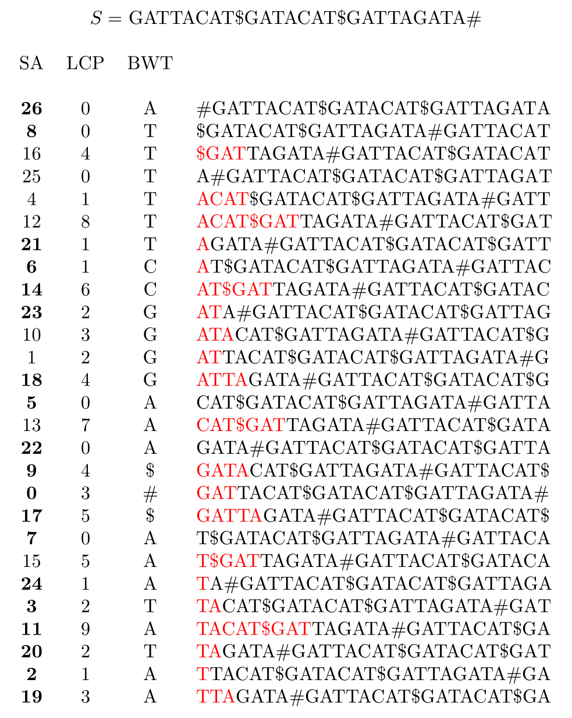
Phi⁻¹
- How does Phi⁻¹ work?
- By using Phi⁻¹ we can recover these intermediate samples.
Notes:
How does Phi inverse work? The best way to see it is by taking note of the fact that if I were to take a pair of samples that are in a run, these two samples will stay as a pair until we reach a run boundary. For example, look at 8 & 16. These two samples share a common bwt character and if we were to step down to 7 & 15 we can see that they share a bwt character as well. This pattern will follow until we reach a run boundary, meaning that those two BWT characters will be different. Let’s continue. 6 & 14, 5 & 13, 4 & 12, stay together up until 3 & 11 where we have found a run boundary. Now Phi inverse works such that if I were at a bwt position and I’d like the next one, I’d find where the first mismatch is between the first sample and the next. Once that is found you can go down and to the right in the bwt, back to the start.

Slide 7

Phi⁻¹ & Random Access
Pred
- By using Phi⁻¹ we can recover these intermediate samples.
26
3
14
24
3
11
21
.
.
.
$${Phi}^{−1}(SA[i])=SA[i+1]$$
- The predecessor of a sample is the first end of a run that precedes it.
E.g., Find SA[3]:
Next sample: 16
Predecessor: 14
Distance: 2
Next sample: 23
(23 + 2) % 27 = 25
Next sample: 8
Predecessor: 3
Distance: 5
Next sample: 11
(11 + 5) % 27 = 16
Preceding end: 26
Predecessor: 26
Distance: 27
Next sample: 8
(8 + 27) % 27 = 8
Notes:
Now how does Phi inverse help us perform random access? I’ll be providing an example using an r-index compressed suffix array. Given a suffix array Phi inverse provides with the following sample so if I were to want say SA[3] I would have to provide Phi inverse with the preceding end of a run, which we have sampled and iterate it however times are needed to get the sample in question. The predecessor of that sample will then be found and the predecessor is simply the first end sample that precedes it. I’ve displayed the next samples predecessors to the left for convenience. In this example we will use 26 which is its own predecessor. In the case that a sample is its own predecessor the distance between the sample and its predecessor will be itself + 1. The step that follows is getting the sample that follows which is also sampled, adding the distance we calculated and modulo it by the size of the bwt. The sample that follows is 8, whos predecessor is 3. The difference 5 will be added to the sample that follows 3, (11). This time around we get 16 and perform one last iteration. 16’s predecessor is 14 and that difference is added to 23 and there we go we accessed SA[3].
Using Phi inverse and an r-index this is how we can perform random access to the suffix array in question. The first step in trying to speed this process up though is going to involve building a graph on our suffix array.

Slide 8
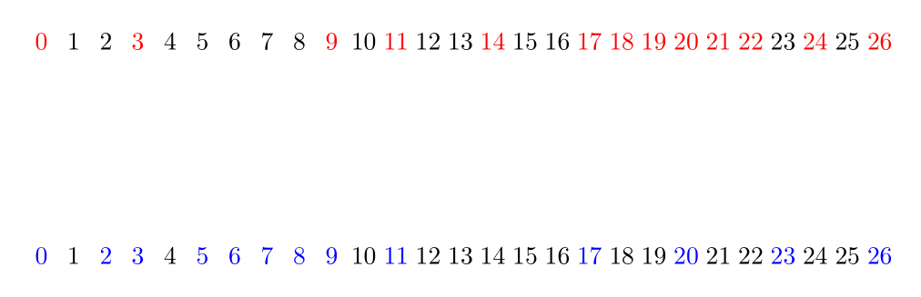
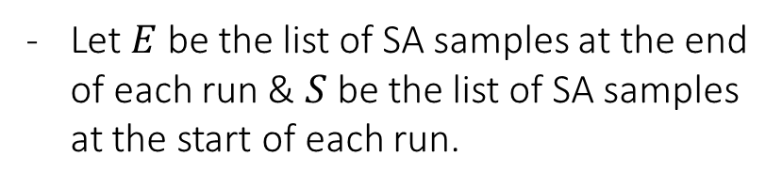
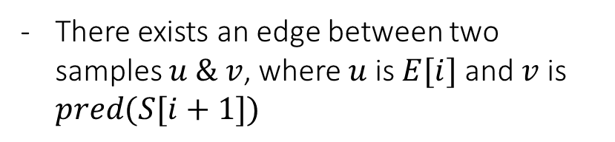
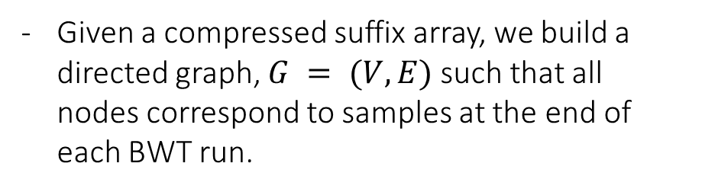
Graph Definition
Pred
S
E
26
3
3
22
3
9
0
17
3
3
11
20
0
26
8
6
23
5
9
0
17
7
3
11
20
2
26
21
14
18
22
9
0
17
24
3
11
20
19
Given a compressed suffix array, we build a directed graph, $G = (V, E)$such that all nodes correspond to samples at the end of each BWT run.
Let $E$ be the list of SA samples at the end of each run & $S$ be the list of SA samples at the start of each run.
There exists an edge between two samples $u \& v$, where $u$ is $E[i]$ and $v$ is $pred(S[i+1])$
Notes:
Given a compressed suffix array we build a directed graph such that all nodes correspond to samples at the end of each BWT run. The lists to the right correspond to the samples at the start and end of each run respectively. To the left I’ve also displayed the predecessor of all start samples for convenience. In our graph an edge exists between two samples u & v, where u is the end sample at index i and v is the predecessor of the start sample at i + 1.

Slide 9
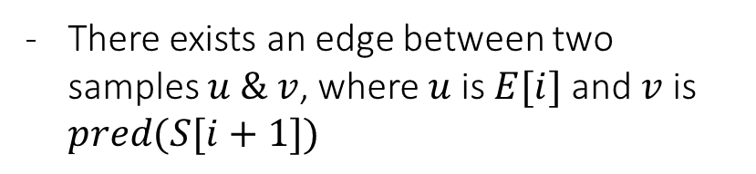
Graph Construction
Pred
S
E
26
3
3
22
3
9
0
17
3
3
11
20
0
26
8
6
23
5
9
0
17
7
3
11
20
2
26
21
14
18
22
9
0
17
24
3
11
20
19
Given a compressed suffix array, we build a directed graph, $G = (V, E)$such that all nodes correspond to samples at the end of each BWT run.
There exists an edge between two samples $u \& v$, where $u$ is $E[i]$ and $v$ is $pred(S[i+1])$
24
26
3
11
20
0
17
21
18
14
22
9
Notes:
The samples we have here are the same as the suffix array in the previous slides as well. Let’s build this graph. Starting off with 26, who points at 8, its predecessor is 3 and we’ve got our first two nodes. We will continue this process from the predecessor value that we just found so 3 points over towards 11 whose predecessor is itself. 11 to 20. 20 to 2 which is 0. 0 to 17. and finally 17 to 7 which bounces us back over to 3 which lets us know to move on to 21. 21 points 3 as well. Over here 14 points over to 22, 22 to 9, and 9 to 0. This last batch of samples all point to 3.
(Properties of the graph): The nodes of the graph have at most outdegree of 1 but have no limit on their indegree. As you can see 3 being pointed to by plenty of neighbors.
(Explain post-construction): This example doesn’t demonstrate this property, but the graph does not need to be connected. Just imagine 9 not pointing over towards 0. That is perfectly valid.
During this process something else that interests us is calculating two values that are stored on the edges of the graph. The cost and limit.

Slide 10
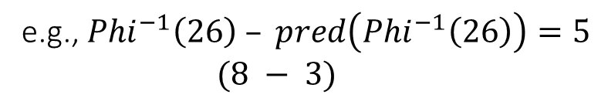

Cost & Limits
Pred
S
E
26
3
3
22
3
9
0
17
3
3
11
20
0
26
8
6
23
5
9
0
17
7
3
11
20
2
26
21
14
18
22
9
0
17
24
3
11
20
19
While constructing the graph, we calculate two values.
$Cost(x) = {Phi}^{−1}(x) – pred({Phi}^{−1}(x))$
e.g., ${Phi}^{−1}\left(26\right) – pred\left({Phi}^{−1}\left(26\right)\right)=5$
$(8 − 3)$
$Limit\left(y\right)=succ(y)−pred(y)$
e.g., $succ\left(3\right)−pred\left(3\right)=6$
Notes:
The graph has been tucked away for a moment to talk about what the costs and limits are. The cost of a particular edge is the difference between the Phi inverse of a sample and its predecessor. For example, the cost of 26 is 5. The limit on the other hand is calculated by finding the difference between the successor, which is the following sampled SA position, and predecessor of a particular sample. Such as 3, who’s successor is 9 and its predecessor is itself. Now that we know how to find costs and limits we can see them as labels on our graph.

Slide 11
Cost & Limits
Pred
S
E
26
3
3
22
3
9
0
17
3
3
11
20
0
26
8
6
23
5
9
0
17
7
3
11
20
2
26
21
14
18
22
9
0
17
24
3
11
20
19
24
(0,2)
(4,1)
26
(5,1)
3
(0,6)
11
(0,3)
20
(2,1)
0
(0,3)
17
(2,1)
(0,2)
(3,1)
21
18
14
(1,3)
22
(0,2)
9
Notes:
We calculated the cost of 26 earlier but I’d like to take note of the fact that as 26 has no successor we would consider “27” to be its successor as we calculate its limit. So we can label it (5,1). With our graph, costs, and limits calculated we can move on to the next step which involves building a tree on the graph of our suffix array.

Slide 12
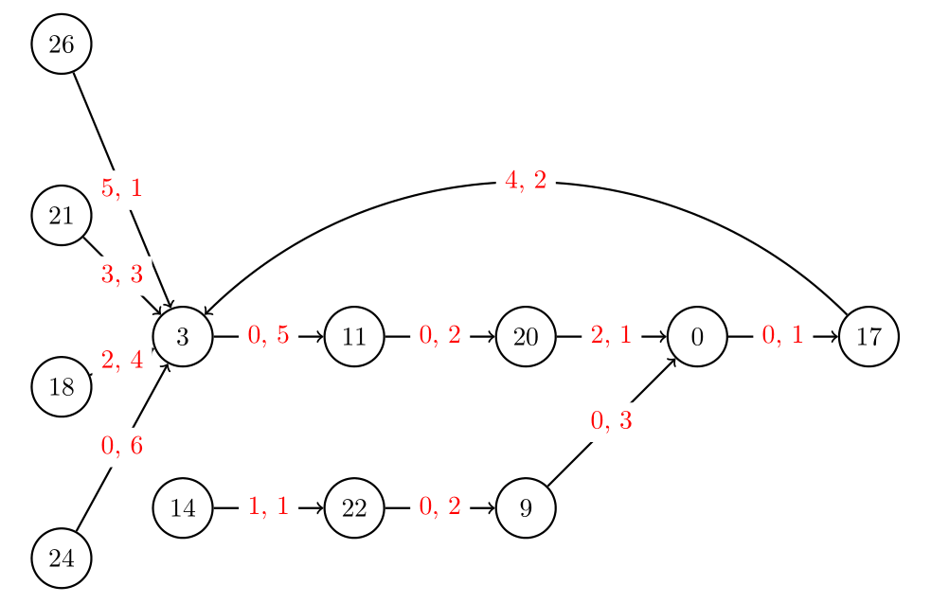
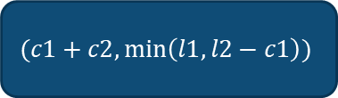
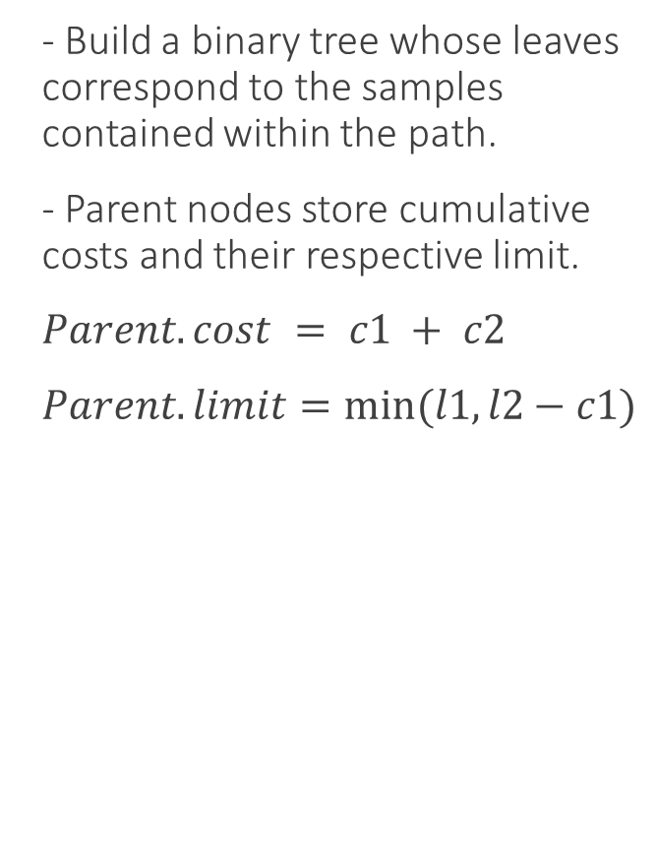
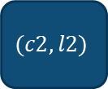
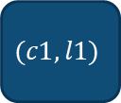
Graph To Tree
- Build a binary tree whose leaves correspond to the samples contained within the path.
- Parent nodes store cumulative costs and their respective limit.
$Parent.cost = c1 + c2$
$Parent.limit=min⁡(l1,l2−c1)$
. . .
$$(c1+c2,\min\left(l1,l2−c1\right))$$
$$(c1,l1)$$
$$(c2,l2)$$
Notes:
Once again our graph is tucked away momentarily. We build a binary tree whose leaves correspond to the samples contained within the path and we recursively build up the parents using the costs and limits which are maintained by the nodes. A parents cost is simply the sum of its two children’s costs and a parent’s limit is the minimum of the left child’s limit compared to the right child’s limit – the left child’s cost.

Slide 13
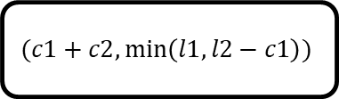
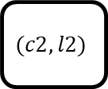
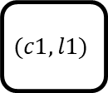
Tree Construction
(4,1)
- Isolate the cycles so that we can have a long, linear path to traverse.
- Recursively build and compute the parents from their leaves.
26
(5,1)
3
(0,6)
11
(0,3)
20
(2,1)
0
(0,3)
17
11,-6
5,-3
6,-1
$$(c1+c2,\min\left(l1,l2−c1\right))$$
5,1
0,2
2,1
4,1
$$(c1,l1)$$
$$(c2,l2)$$
11
17
5,1
0,6
2,1
0,3
26
3
20
0
Notes:
On this slide you can see that we’re missing a decent chunk of the graph and the reason for that is because we are only building this tree on the cycle that was contained within the graph. The reason for this is that we would like to have a linear path that is also ideally long. Just as I said earlier the leaves are the samples that are displayed above and for this example we can build the tree as such. The first pair of parents will store 5,1 and 2,1 which is calculated just as we said earlier, and each parent covers a particular interval of samples at the bottom. This tree is what we will be using to query the suffix array momentarily.

Slide 14
Steps to Query Tree
- Climbing until our cost exceeds the limit of the tree.
- This expands our search.
- Descend until we reach a leaf node to exit on.
- This refines our search.
Notes:
I would like break down the idea behind the query process briefly on a large tree so that it’s a little clearer what’s happening. In the new query process, we will be entering the tree from a particular leaf so lets we enter using the node being circled. We would climb up the tree checking that the cost we have entered the tree with is smaller than the limit of the current node and while that is true it means that we can skip past this interval of SA samples. Once we are denied or we reach the root it’s time to descend which means we collect our left child’s cost and begin refining our search. The first node of the right subtree has denied us access meaning we move down to it’s left subtree where it seems we are fine. The right subtree though tells us to hold up, so we continue down the left subtree and are once again denied meaning that as we go down to the left for the last time we finally have reached a leaf node. This marks our exit and we have been able to skip from the first node all the way to this one. Now for a real example.

Slide 15
New Query Process
BV
1
-
-
-
-
-
0
-
0
-
-
-
0
-
-
0
0
1
1
-
-
0
1
1
1
-
0
11,-6
E.g., Find SA[3]: (25)
Previous end: 26
Predecessor: 26
Distance: 3
Cost: 0
In cycle? True.
5,-3
6,-1
5,1
0,2
2,1
4,1
11
17
Next sample: 16
Predecessor: 14
In cycle? No.
Use Phi⁻¹.
5,1
0,6
2,1
0,3
26
3
20
0
Notes:
Using the same suffix array as before let’s look for the same sample we were wondering about: SA[3].
We begin with the same steps. Find the end of the preceding run, 26, get its predecessor real quick and were going to find the actual difference this time around between the sample and its predecessor, which is just 0 This is going to be our cost when we enter the tree. In addition to this though we get the distance between the sample being queried and the index of the sample we are using. So we’re going from 0 to 3. At this point we can ask the question, was this sample in a cycle? Or better said the path we built our tree on and that is true in this case. We come into the tree and begin climbing as I explained earlier. Our cost is less than the limit of the node and we’re allowed to keep climbing until the node labelled 5,-3. here we are denied and have to being the descent where we immediately find ourselves at the leaf node representing 11. At this point we collect the left childs cost which was 5 and add it to the leaf node we exit on. 11 + 5 and we get 16. The sample at SA[2] because we hopped past two samples in the process of traversing the tree. We’ve just one last step though and that is asking the same question of 16. Is it’s predecessor in a cycle? This time around it will not be the case so we just have to use Phi inverse. Essentially though what we’ve done is go from using phi 3 times to simply once in this case.

Slide 16
(Quick Compare Between Iterating Phi & Tree?)

Slide 17
(Experiments That Will Be Conducted)
Future Work
- Comparing against recent implementations of different compressed suffix arrays. Such as the r-index, sr-index, RLZ-CSA, BT-CSA, Dynamic r-index, LCSA, and CDAWG.
- Datasets will include Chromosome 19 and SARS.

Slide 18
Thank You!
Thanks for your time and attention.

Slide 19
S = GATTACAT$GATACAT$GATTAGATA#
SA
BWT
LCP
26 0 A #GATTACAT$GATACAT$GATTAGATA
8 0 T $GATACAT$GATTAGATA#GATTACAT
16 4 T $GATTAGATA#GATTACAT$GATACAT
25 0 T A#GATTACAT$GATACAT$GATTAGAT
4 1 T ACAT$GATACAT$GATTAGATA#GATT
12 8 T ACAT$GATTAGATA#GATTACAT$GAT
21 1 T AGATA#GATTACAT$GATACAT$GATT
6 1 C AT$GATACAT$GATTAGATA#GATTAC
14 6 C AT$GATTAGATA#GATTACAT$GATAC
23 2 G ATA#GATTACAT$GATACAT$GATTAG
10 3 G ATACAT$GATTAGATA#GATTACAT$G
1 2 G ATTACAT$GATACAT$GATTAGATA#G
18 4 G ATTAGATA#GATTACAT$GATACAT$G
5 0 A CAT$GATACAT$GATTAGATA#GATTA
13 7 A CAT$GATTAGATA#GATTACAT$GATA
22 0 A GATA#GATTACAT$GATACAT$GATTA
9 4 $ GATACAT$GATTAGATA#GATTACAT$
0 3 # GATTACAT$GATACAT$GATTAGATA#
17 5 $ GATTAGATA#GATTACAT$GATACAT$
7 0 A T$GATACAT$GATTAGATA#GATTACA
15 5 A T$GATTAGATA#GATTACAT$GATACA
24 1 A TA#GATTACAT$GATACAT$GATTAGA
3 2 T TACAT$GATACAT$GATTAGATA#GAT
11 9 A TACAT$GATTAGATA#GATTACAT$GA
20 2 T TAGATA#GATTACAT$GATACAT$GAT
2 1 A TTACAT$GATACAT$GATTAGATA#GA
19 3 A TTAGATA#GATTACAT$GATACAT$GA

Slide 20
26 0 #GATTACAT$GATACAT$GATTAGAT A #GATTACAT$GATACAT$GATTAGATA
8 0 $GATACAT$GATTAGATA#GATTACA T $GATACAT$GATTAGATA#GATTACAT
16 4 $GATTAGATA#GATTACAT$GATACA T $GATTAGATA#GATTACAT$GATACAT
25 0 A#GATTACAT$GATACAT$GATTAGA T A#GATTACAT$GATACAT$GATTAGAT
4 1 ACAT$GATACAT$GATTAGATA#GAT T ACAT$GATACAT$GATTAGATA#GATT
12 8 ACAT$GATTAGATA#GATTACAT$GA T ACAT$GATTAGATA#GATTACAT$GAT
21 1 AGATA#GATTACAT$GATACAT$GAT T AGATA#GATTACAT$GATACAT$GATT
6 1 AT$GATACAT$GATTAGATA#GATTA C AT$GATACAT$GATTAGATA#GATTAC
14 6 AT$GATTAGATA#GATTACAT$GATA C AT$GATTAGATA#GATTACAT$GATAC
23 2 ATA#GATTACAT$GATACAT$GATTA G ATA#GATTACAT$GATACAT$GATTAG
10 3 ATACAT$GATTAGATA#GATTACAT$ G ATACAT$GATTAGATA#GATTACAT$G
1 2 ATTACAT$GATACAT$GATTAGATA# G ATTACAT$GATACAT$GATTAGATA#G
18 4 ATTAGATA#GATTACAT$GATACAT$ G ATTAGATA#GATTACAT$GATACAT$G
5 0 CAT$GATACAT$GATTAGATA#GATT A CAT$GATACAT$GATTAGATA#GATTA
13 7 CAT$GATTAGATA#GATTACAT$GAT A CAT$GATTAGATA#GATTACAT$GATA
22 0 GATA#GATTACAT$GATACAT$GATT A GATA#GATTACAT$GATACAT$GATTA
9 4 GATACAT$GATTAGATA#GATTACAT $ GATACAT$GATTAGATA#GATTACAT$
0 3 GATTACAT$GATACAT$GATTAGATA # GATTACAT$GATACAT$GATTAGATA#
17 5 GATTAGATA#GATTACAT$GATACAT $ GATTAGATA#GATTACAT$GATACAT$
7 0 T$GATACAT$GATTAGATA#GATTAC A T$GATACAT$GATTAGATA#GATTACA
15 5 T$GATTAGATA#GATTACAT$GATAC A T$GATTAGATA#GATTACAT$GATACA
24 1 TA#GATTACAT$GATACAT$GATTAG A TA#GATTACAT$GATACAT$GATTAGA
3 2 TACAT$GATACAT$GATTAGATA#GA T TACAT$GATACAT$GATTAGATA#GAT
11 9 TACAT$GATTAGATA#GATTACAT$G A TACAT$GATTAGATA#GATTACAT$GA
20 2 TAGATA#GATTACAT$GATACAT$GA T TAGATA#GATTACAT$GATACAT$GAT
2 1 TTACAT$GATACAT$GATTAGATA#G A TTACAT$GATACAT$GATTAGATA#GA
19 3 TTAGATA#GATTACAT$GATACAT$G A TTAGATA#GATTACAT$GATACAT$GA

